Slide 1
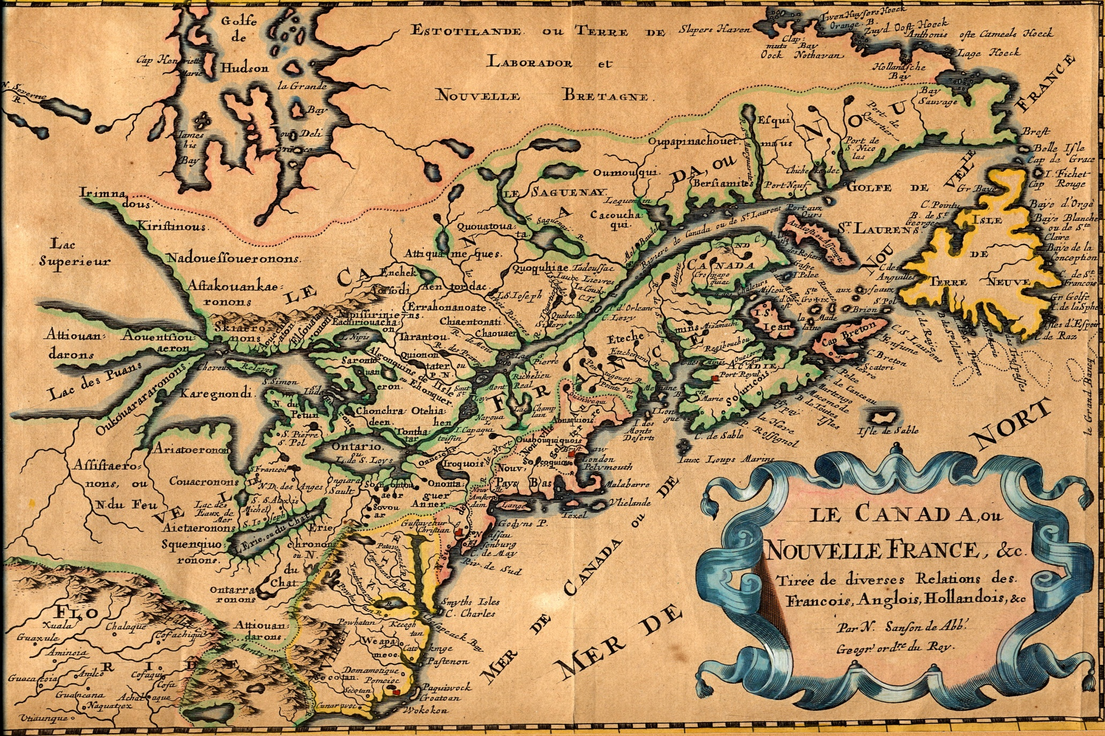
French Map of New France, c 1660

Slide 2
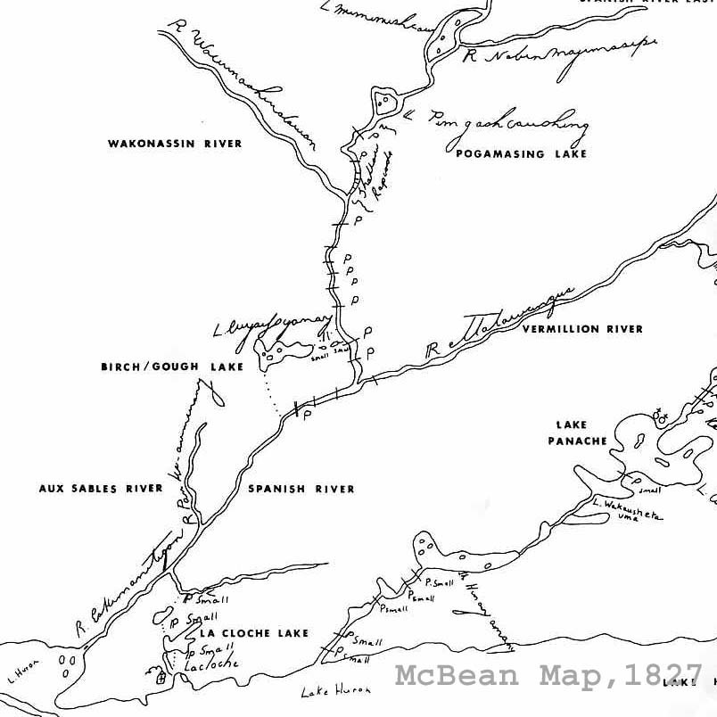
John McBean Map of Spanish River, 1827

Slide 3
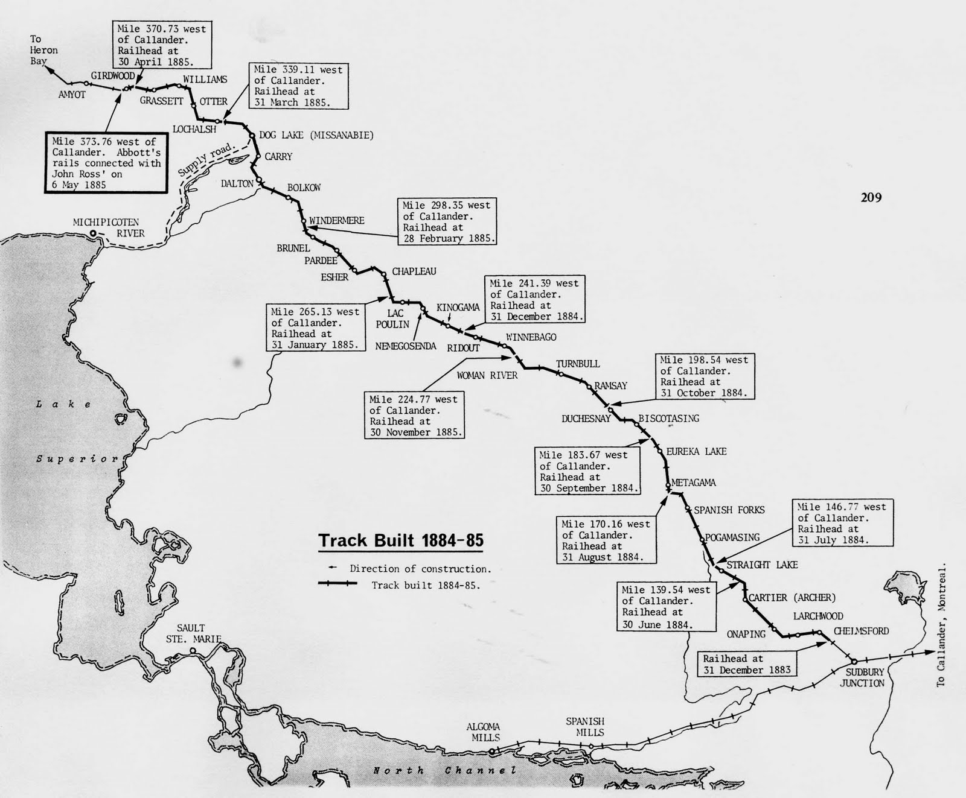
Building the CPR, 1884

Slide 4
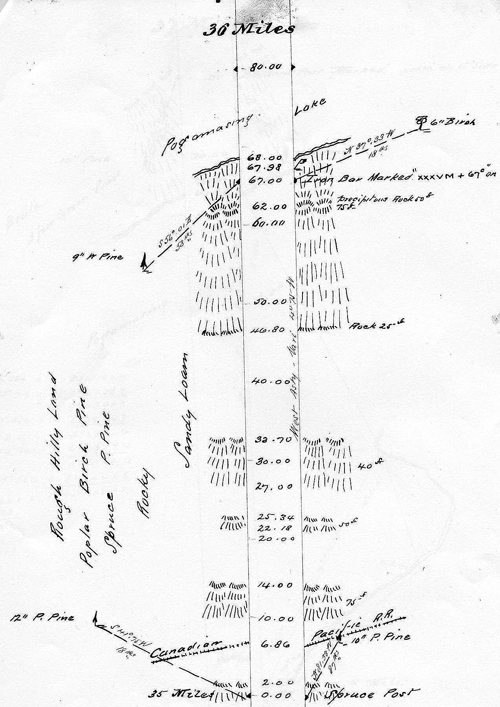
Proudfoot one mile survey line of the 42-mile survey, 1888 - crossed CPR and Pog

Slide 5
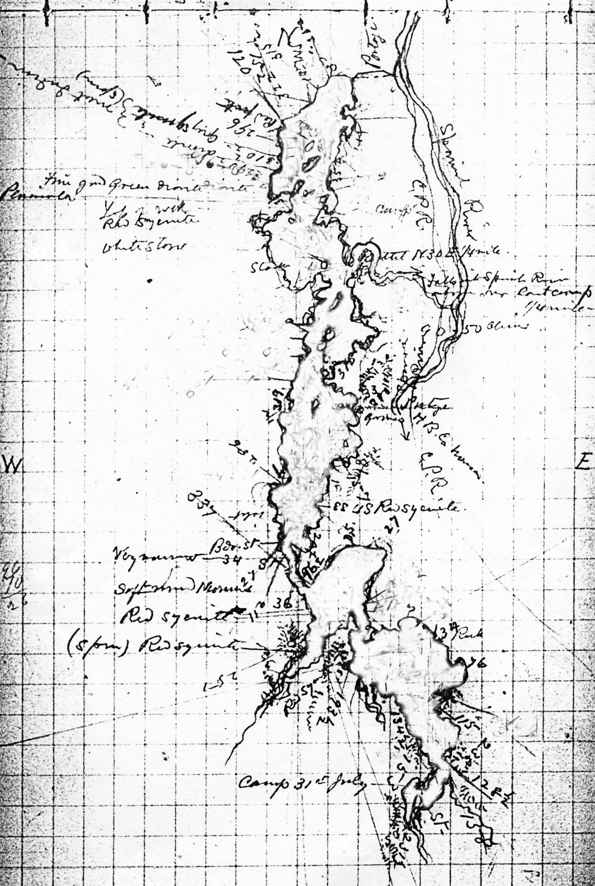
Robert Bell Map of Pog, 1889

Slide 6
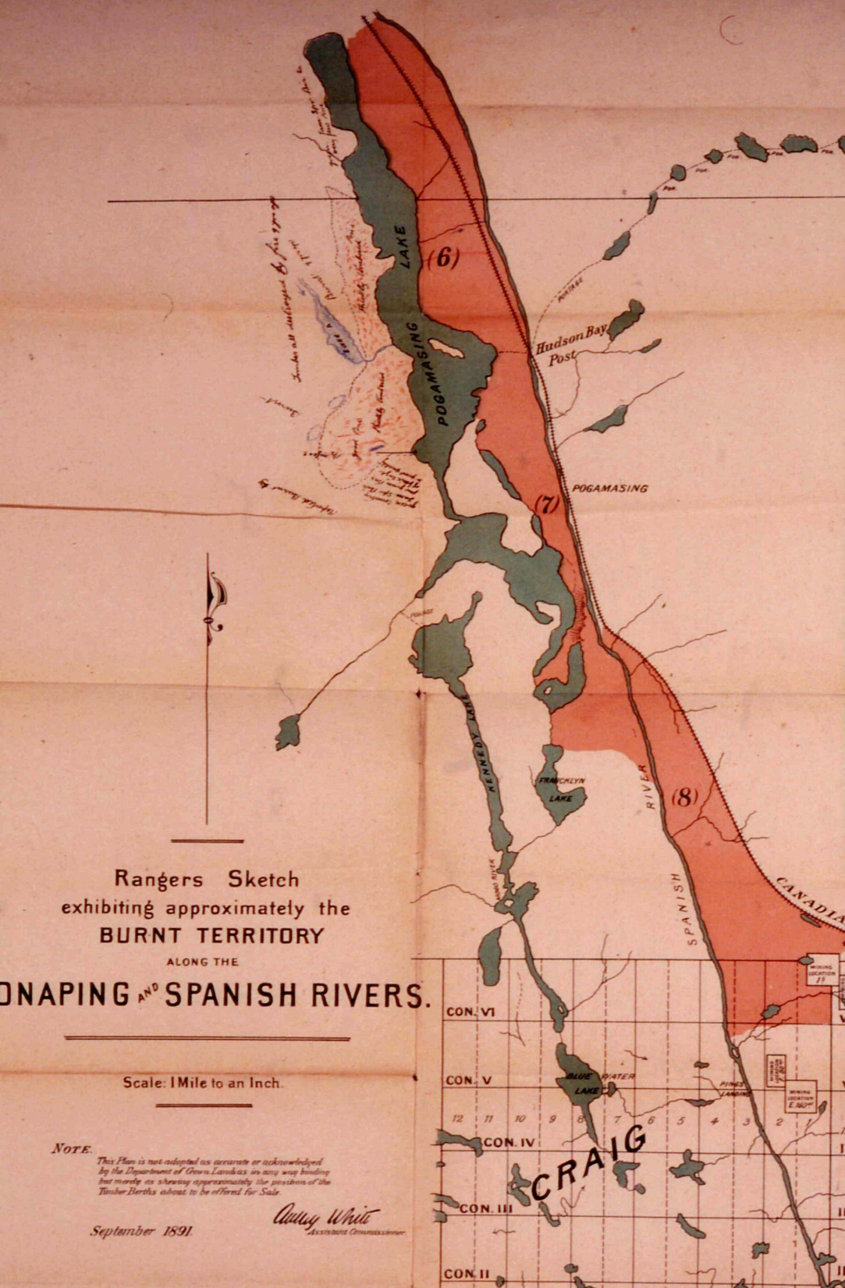
Map of Burnt Timber for Auction, 1891. Proudfoot’s Line can be seen and notes about a forest fire that came earlier than the 1890 fire

Slide 7
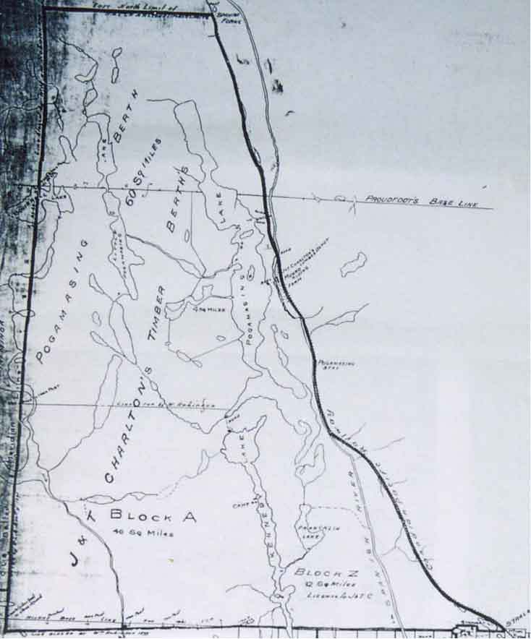
First Timber Berths, 1903

Slide 8
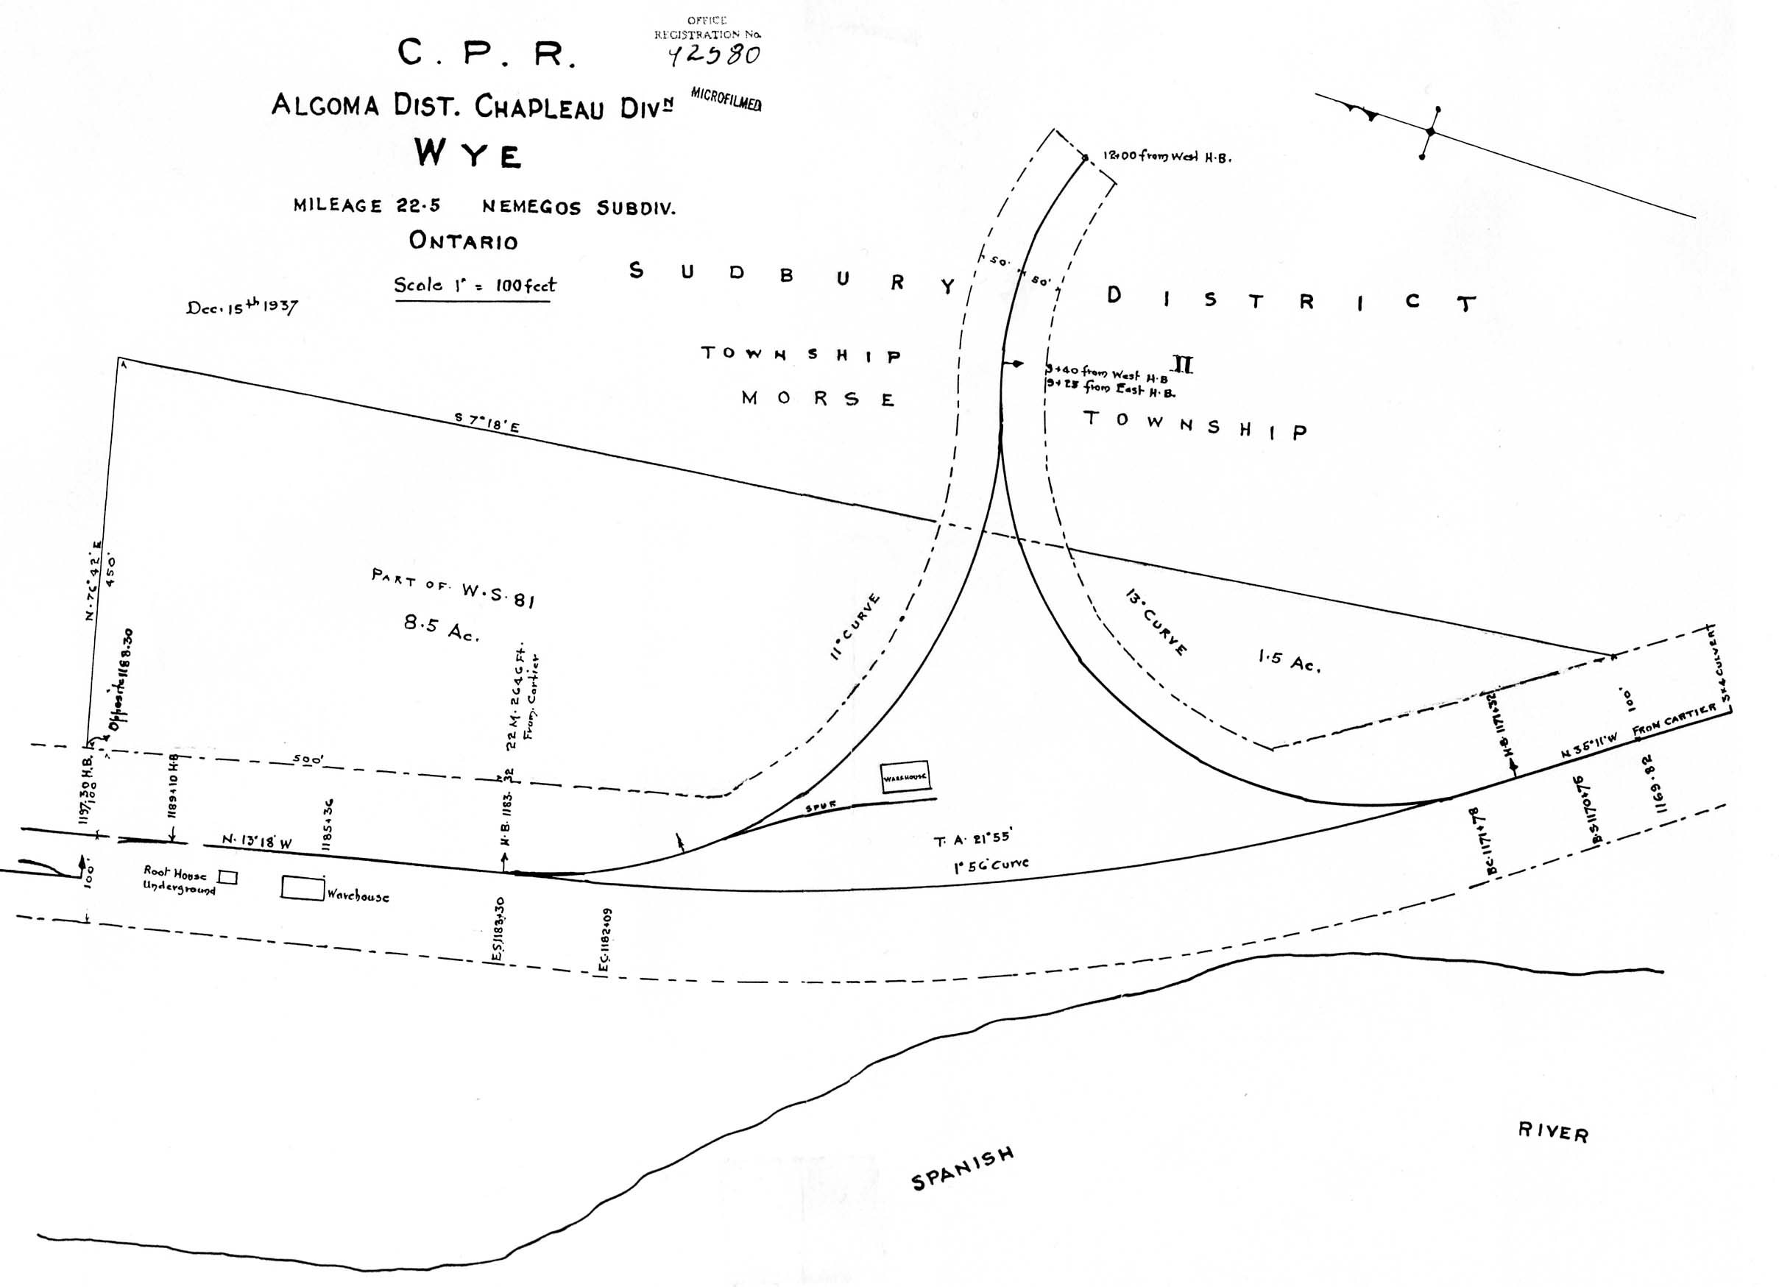
Creation of Railway ‘Y”, hence the name of the stop, Wye, 1917

Slide 9
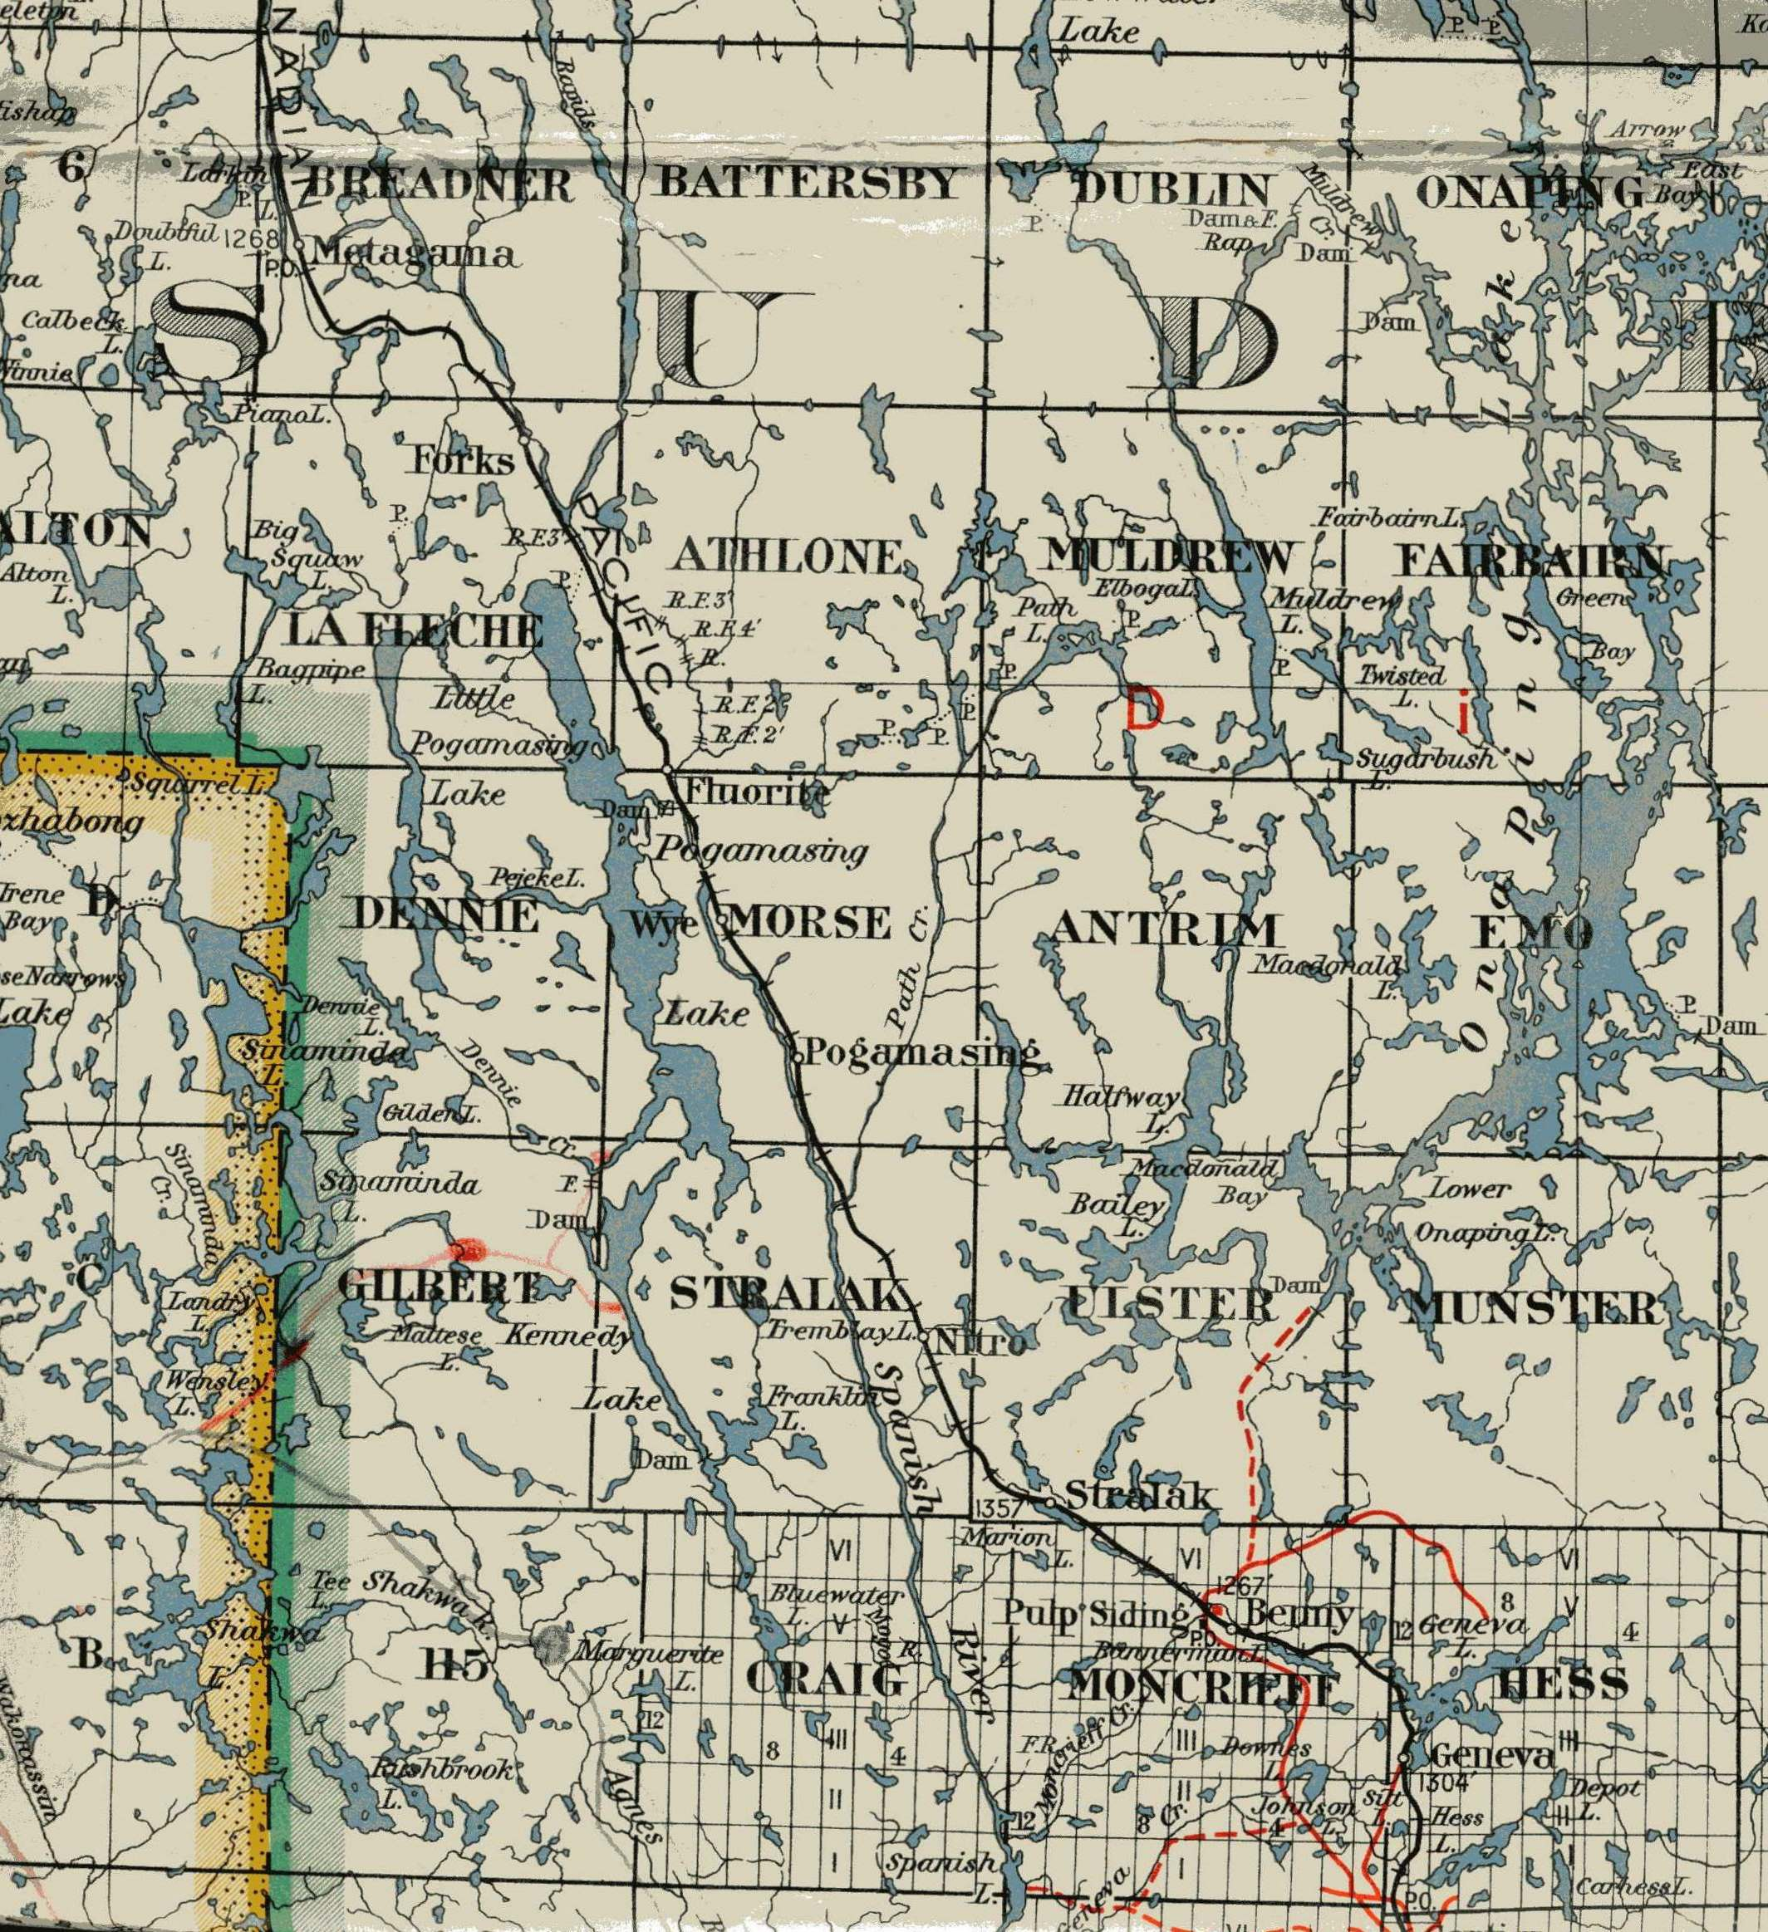
Map of Townships, 1940-50s

Slide 10
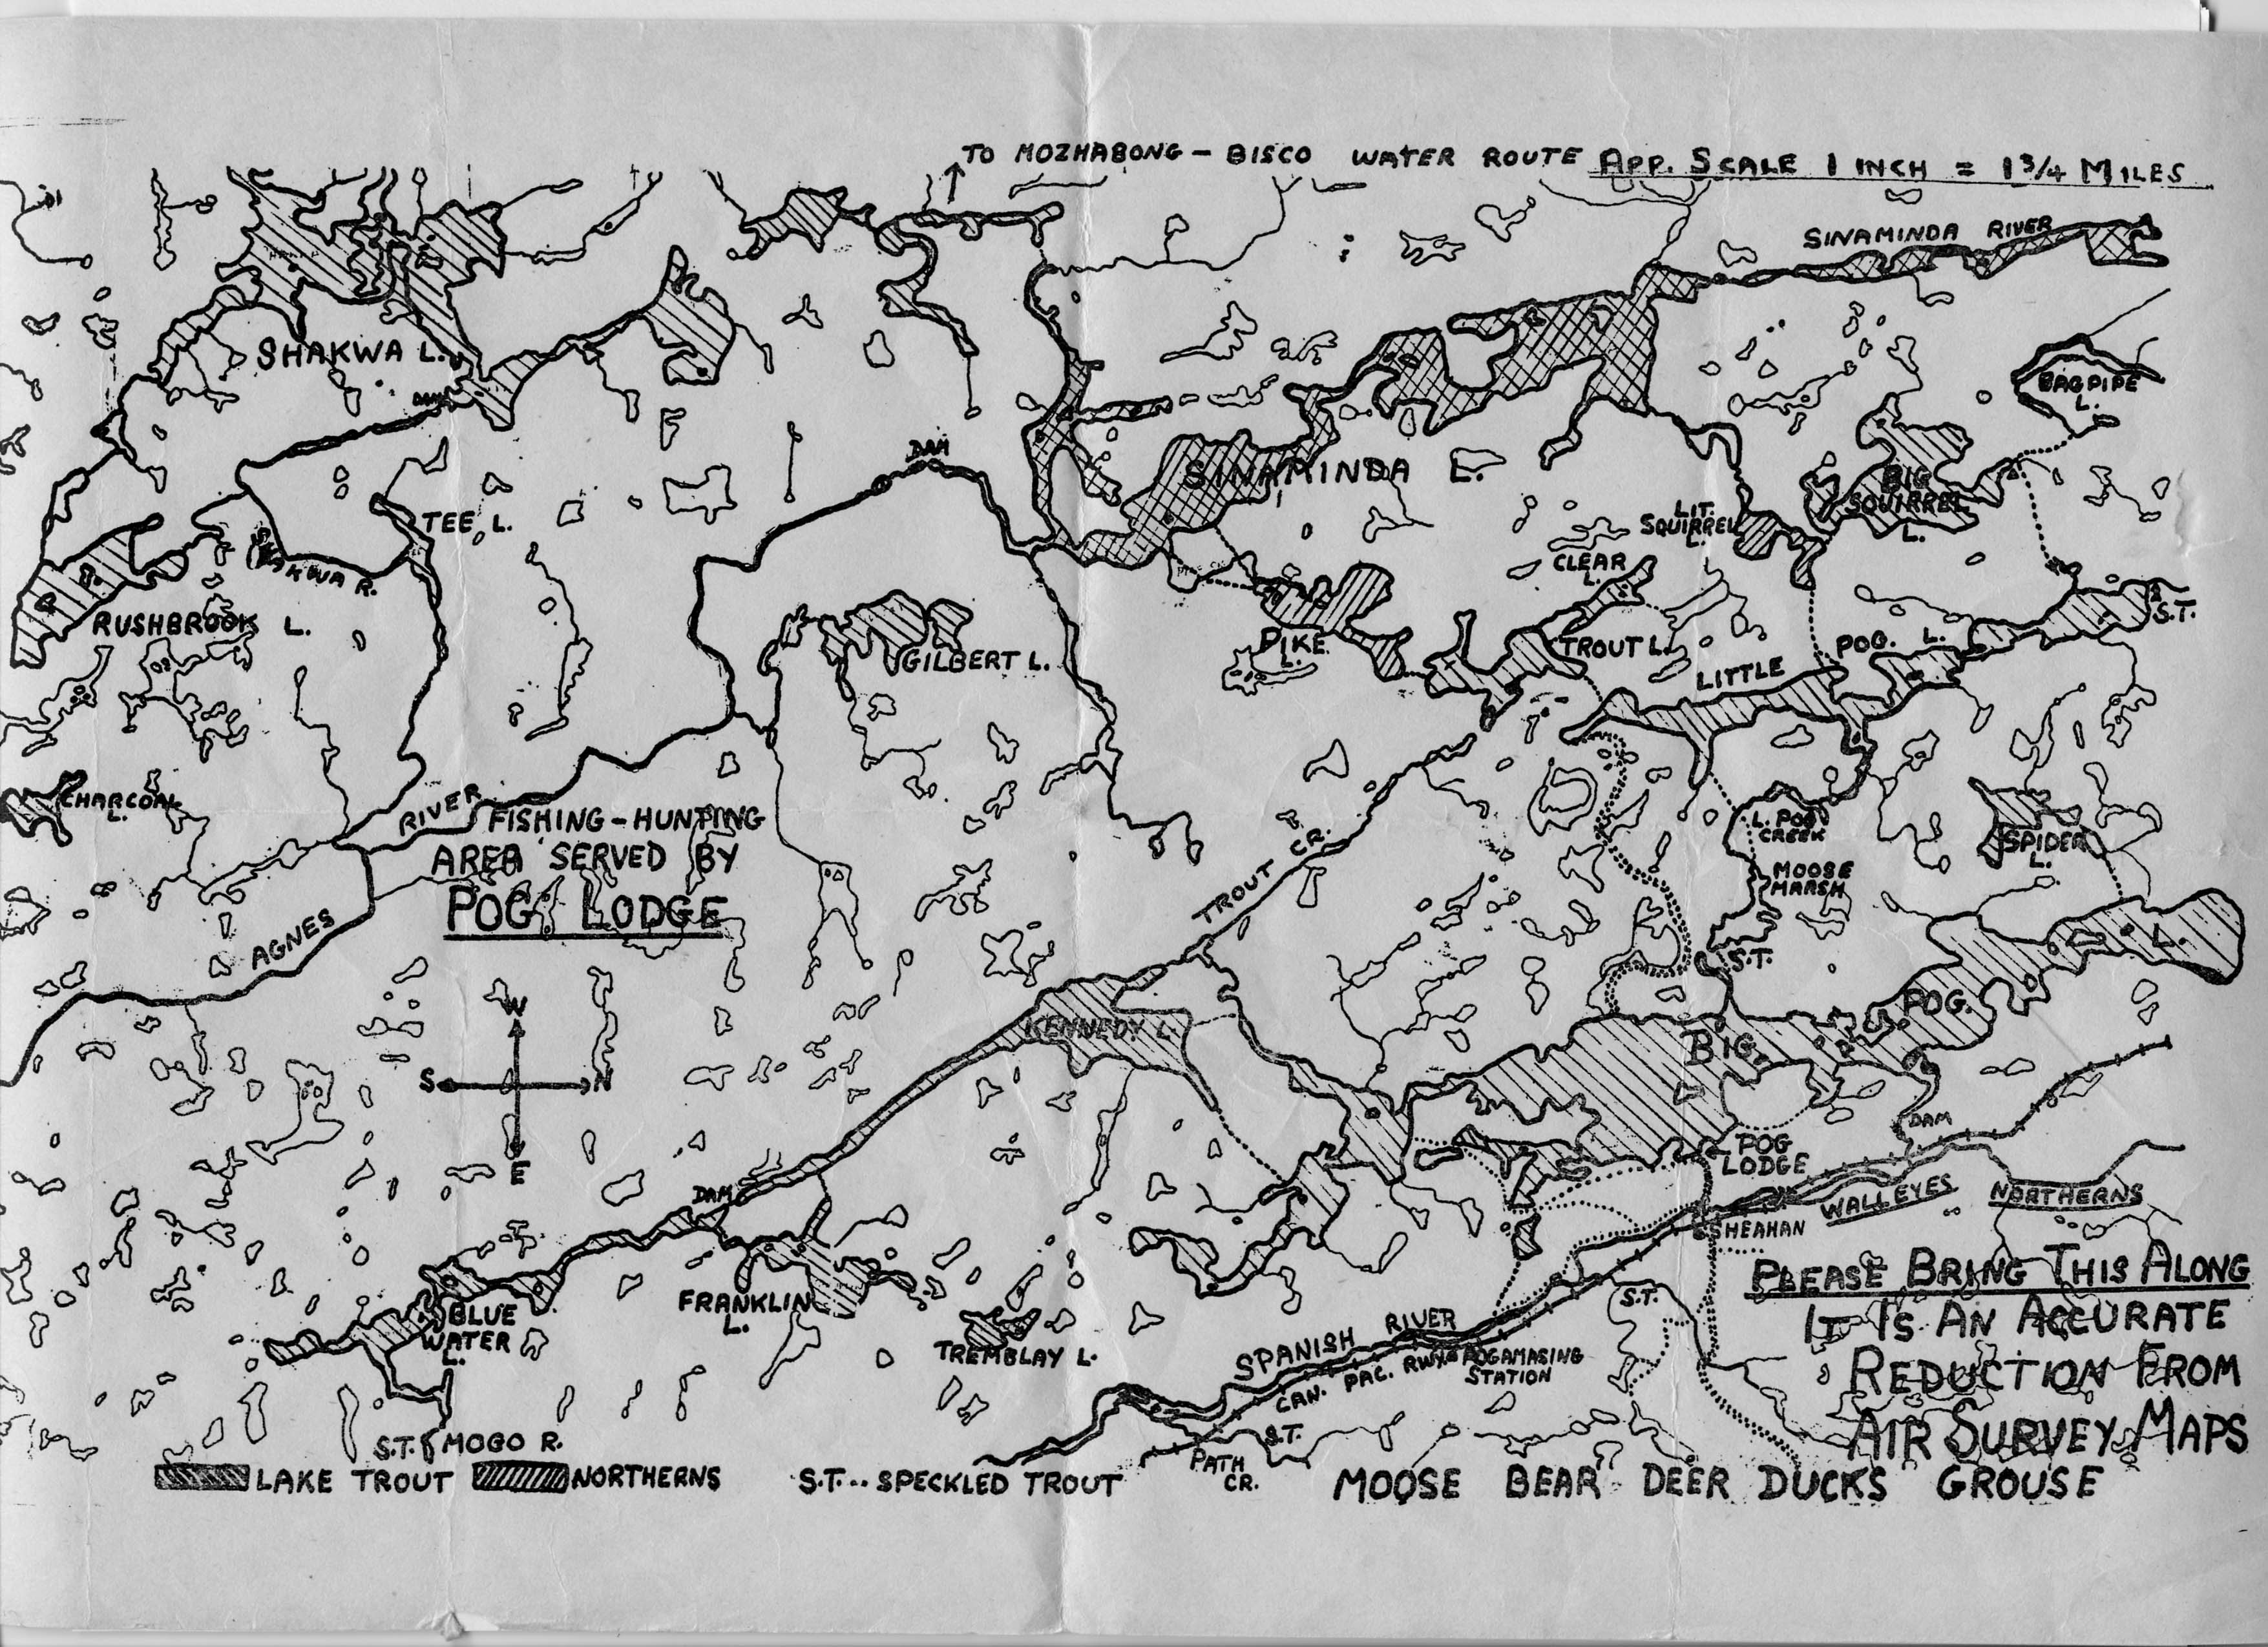
Pog Lodge Map for Guests, 1950

Slide 11
